Slide 1
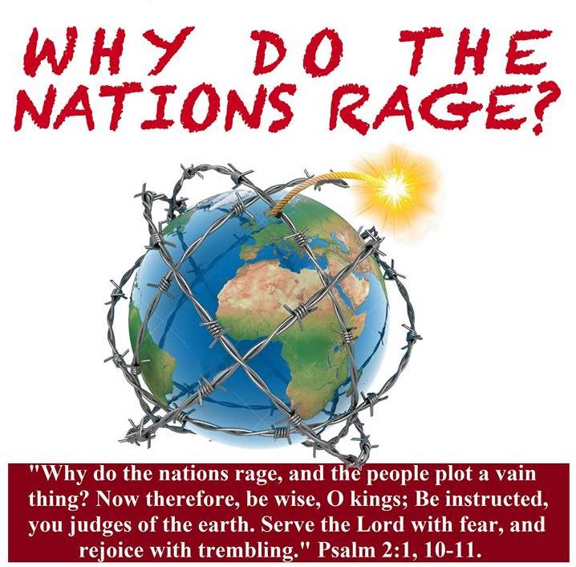
Evangelism and Missions
Go ye into all the world,
and preach the gospel to every creature.
Mark 16:15

Slide 2
Are Missionaries still Needed?

Slide 3
The Biblical Mandate for Evangelism
Joh 20:21 Then said Jesus to them again, Peace be unto you: as my Father hath sent me, even so send I you.
Mat 28:19 Go ye therefore, and teach all nations, baptizing them in the name of the Father, and of the Son, and of the Holy Ghost:
Mar 16:15 And he said unto them, Go ye into all the world, and preach the gospel to every creature.
Luk 24:47 And that repentance and remission of sins should be preached in his name among all nations, beginning at Jerusalem.
Act 1:8 But ye shall receive power, after that the Holy Ghost is come upon you: and ye shall be witnesses unto me both in Jerusalem, and in all Judaea, and in Samaria, and unto the uttermost part of the earth.

Slide 4
Are Missionaries still Needed?
1970
World population 3 ½ billion
Missionaries connected with North American assemblies
498
2017
World population 7 ½ billion
Missionaries connected with North American assemblies
700

Slide 5
Are Missionaries still Needed?
Nearly all future population growth will be in the world’s less developed countries.

Slide 6
Growth Rate Comparison
Billions
Less Developed Regions
33%
11%
More Developed Regions

Slide 7
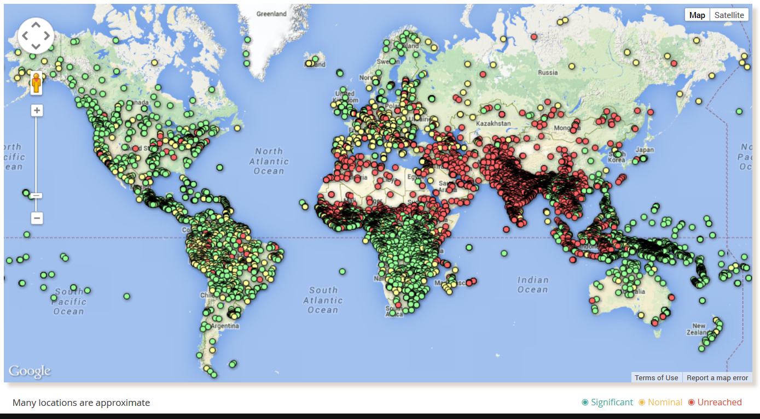
Green dot represents significant Christians testimony
Yellow dot represents nominal Christians testimony
Red dot represents unreached people

Slide 8

What Does The World Population Really Look Like ?
    For every 100 people on the planet:
    57 are Asian
    21 are European
    14 are from the Americas
    8 are African
    52 are female
    70 are not white
    70 are not Christian
    80 live in substandard housing
    70 cannot read and write
    1 has a college education
    1 owns a computer
    50 are malnourished
    60 have a cell phone

Slide 9
What are the problems?
Obstacles with the target groups
  Why don’t they believe what we are saying?
Obstacles with us
  Why don’t we believe what we are saying?

Slide 10
What are the problems?
Obstacles with the target groups
  Why don’t they believe what we are saying?
  Blinded by Satan 2 Cor 4:3
  Post-Christian mind… seen it all, done it all, got the Jesus T-shirt
  Affluence “it is easier for a camel to go through a needle's eye,” Lk 18:25
  The behaviour of celebrity Christians

Slide 11
What are the problems?
Obstacles with us
    Why don’t we believe what we are saying?
  What we profess to believe and what we really believe are often not the same.
  There are underlying doubts and unanswered questions that undermine our ability to effectively communicate the gospel to people.

Slide 12
What are the problems?
Obstacles with us
    People will not buy your product if you don’t really believe in it!

Slide 13
Unbelieving believers
Do we really believe what we profess to believe?
  Mankind by nature and by birth is sinful with absolutely no capacity to obtain salvation by his own merits. Mankind is lost and doomed to eternal punishment. Salvation is available to all only on the basis of the value of the death of Christ and His blood. The individual who accepts this provision has the assurance of heaven and eternal life. The individual who rejects this provision “will not see life, but the wrath of God abides on him”. John 3:36 John 3:17

Slide 14
Unbelieving believers
Do we really believe what we profess to believe?
  Mankind by nature and by birth is sinful with absolutely no capacity to obtain salvation by his own merits. Mankind is lost and doomed to eternal punishment. Salvation is available to all only on the basis of the value of the death of Christ and His blood. The individual who accepts this provision has the assurance of heaven and eternal life. The individual who rejects this provision “will not see life, but the wrath of God abides on him”. John 3:36 John 3:17

Slide 15
Why Evangelism?
People are lost!
  Is this really true?
We have the truth!
  Is this really true?
Do I really believe it?

Slide 16
Why Evangelism?
People are lost!
We have the truth!
Do I really believe it?
If I doubt it, the world will detect it!

Slide 17
What are the problems?
Obstacles with us
  If we are not absolutely convinced that we have the truth we will have a difficult time persuading others to embrace this truth.
  1Pe 3:15 But sanctify the Lord God in your hearts: and be ready always to give an answer to every man that asketh you a reason of the hope that is in you with meekness and fear:

Slide 18
What are the problems?
Obstacles with us
  Why don’t we believe what we are saying?
    Not sure if the heathen are really lost
    Do we really believe we have the only message that saves? (moral relativism and tolerance)

Slide 19
The Conclusion
Obstacles with us
  We need to revisit the PERIL and NEED of the lost
  We need to revisit the VALUE and EXCUSIVITY of the message

